Slide 1
The Zen of Coding
Day 1

Slide 2

Quick Introductions! (30 seconds)
Name
Location
Background (Career, Education, Interests)
Why learn web development?
Fears about class?

Slide 3
Instructor = … ?
Your Name Here
<insert education or experience tidbit>
<insert education or experience tidbit>
Over <#> years coding, (with plenty of experience being a n00b at it.)
Insert image of you here
<personal fact>
Secretly, a <funny fact about yourself>
Insert image here

Slide 4
Some Cool Stuff I Made…
SNAPSHOT OF SOMETHING
YOU MADE GOES HERE!

Slide 5
The Path of Learning

Slide 6
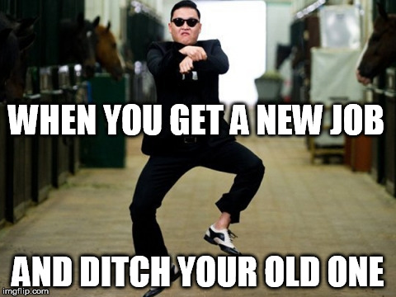
Your Goals...
New Career
Basically 1000% of you said…

Slide 7
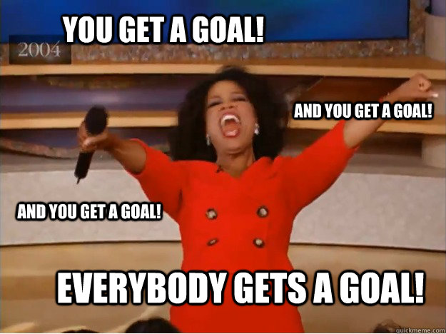
Your Goals...
And why do you want a new career?
To escape a “dead-end job”
To pursue a “dream”
To be able to “create”
To follow a “fascination”
To attain “financial stability”
To attain “financial freedom”
To “challenge” yourself
To be a “role model” for kids

Slide 8
Your Goal = Our Goal
As instructors,
we take your goals very, very seriously.

Slide 9
Support Team
Our Promise:
If you’re willing to put in the time – and you take our advice, we’re here to help you 100% of the way.
This goes for everyone working behind the program:
Instructors
TAs
Student Success Team
Career Coaches
Everyone Else!

Slide 10
But Remember…
Nothing good comes easy.

Slide 11
On Keys To Success…

Slide 12

Don’t Be This Guy…
Notes:
Those that have the hardest time in the program are not the ones who came in knowing no programming.
It’s not the ones who haven’t played around with HTML, CSS, or Javascript.
It’s the ones who walk in thinking they either A) Know more than they do. Or B) Are experts in a completely different field.
There is something that stops people like this from accepting the reality.

Slide 13

This Should Be You.

Slide 14
Our Mantra for Today and Beyond…
When it comes to web development…

Slide 15
Our Mantra for Today and Beyond…
I know nothing.

Slide 16
You.
Notes:
Seriously. Don’t lose sight of this image. At first it may feel intimidating. Knowing how little you know. But relish the opportunity and take the privileges it comes with.
You have permission to struggle. To fail. To not “get” everything immediately.

Slide 17
The Path of Learning

Slide 18
Nothing Comes Easy…
As students, you face three
HUGE obstacles!

Slide 19
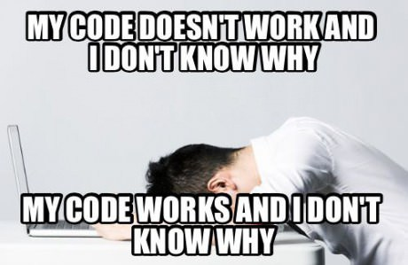
Obstacle #1 – The Great Confusion

Slide 20

Obstacle #2 – The Great Doubt

Slide 21

Obstacle #3 – The Great Distance

Slide 22
Nothing Comes Easy…
Learning to Code Requires Two Things:
Persisting in the face of something that feels incredibly hard and confusing.
Maintaining the self-confidence necessary to believe that you CAN DO THIS.

Slide 23
Learning is “Frustrating”
“You can’t tell whether you’re learning something when you’re learning it—in fact, learning feels a lot more like frustration.”
“What I’ve learned is that during this period of frustration is actually when people improve the most, and their improvements are usually obvious to an outsider. If you feel frustrated while trying to understand new concepts, try to remember that it might not feel like it, but you’re probably rapidly expanding your knowledge.”
Jeff Dickey, Author of Write Modern Web Apps with the MEAN Stack: Mongo, Express, AngularJS, and Node.JS

Slide 24
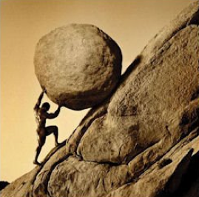
Advice for the Journey
Throughout this course, always remember to:
Work Hard!!

Slide 25
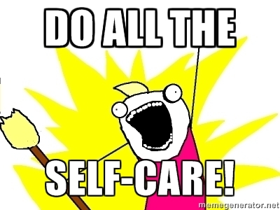
Advice for the Journey
Throughout this course, always remember to:
Work Hard!!
Appreciate your successes

Slide 26

Advice for the Journey
Throughout this course, always remember to:
Work Hard!!
Appreciate your successes
Trust yourself

Slide 27
Course Structure

Slide 28
Daily Schedule
For each class we’ll run through the following:
Set Objectives
Brief Background Lecture
Watch Me / Coding Demos
Code Discussions
In-Class Exercises
Project Work

Slide 29
Daily Schedule
For each class we’ll run through the following:
Set Objectives
Brief Background Lecture
Watch Me / Coding Demos
Code Discussions
In-Class Exercises
Project Work
The Super Important Stuff!!!
i.e. Always be coding!

Slide 30
Pre-Work

Slide 31
Software Checklist
At this point, you should have each of these installed:
Slack
Sublime Text 3
Git for Version Control
Git Bash (Windows) or Terminal (Mac)
Node.js
Heroku Toolbelt
Google Chrome

Slide 32
Accounts Checklist
You should also now have accounts for:
GitHub (with SSH Integration)
Heroku
LinkedIn
Stack Overflow

Slide 33
Self-Check
Let’s do some quick checks of the following
Sublime Check
Git Bash / Terminal Check
Node Check
Git Check
Heroku Check

Slide 34
On the Modern Web

Slide 35
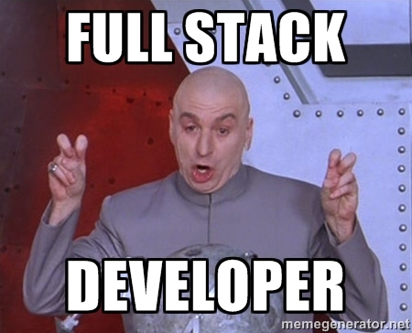
Full-Stack Development?

Slide 36
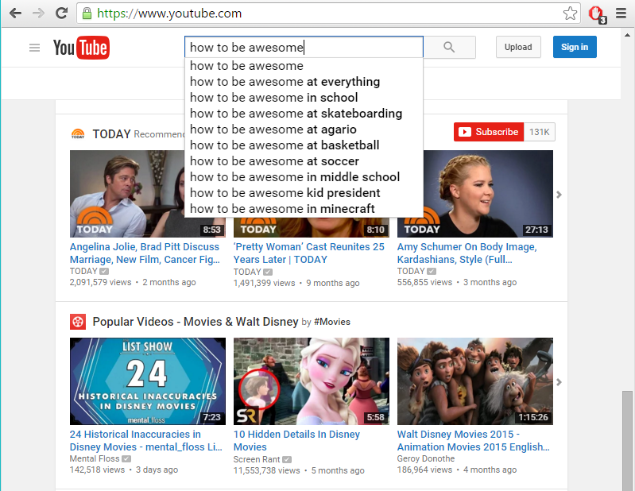
The “Magic” of YouTube

Slide 37
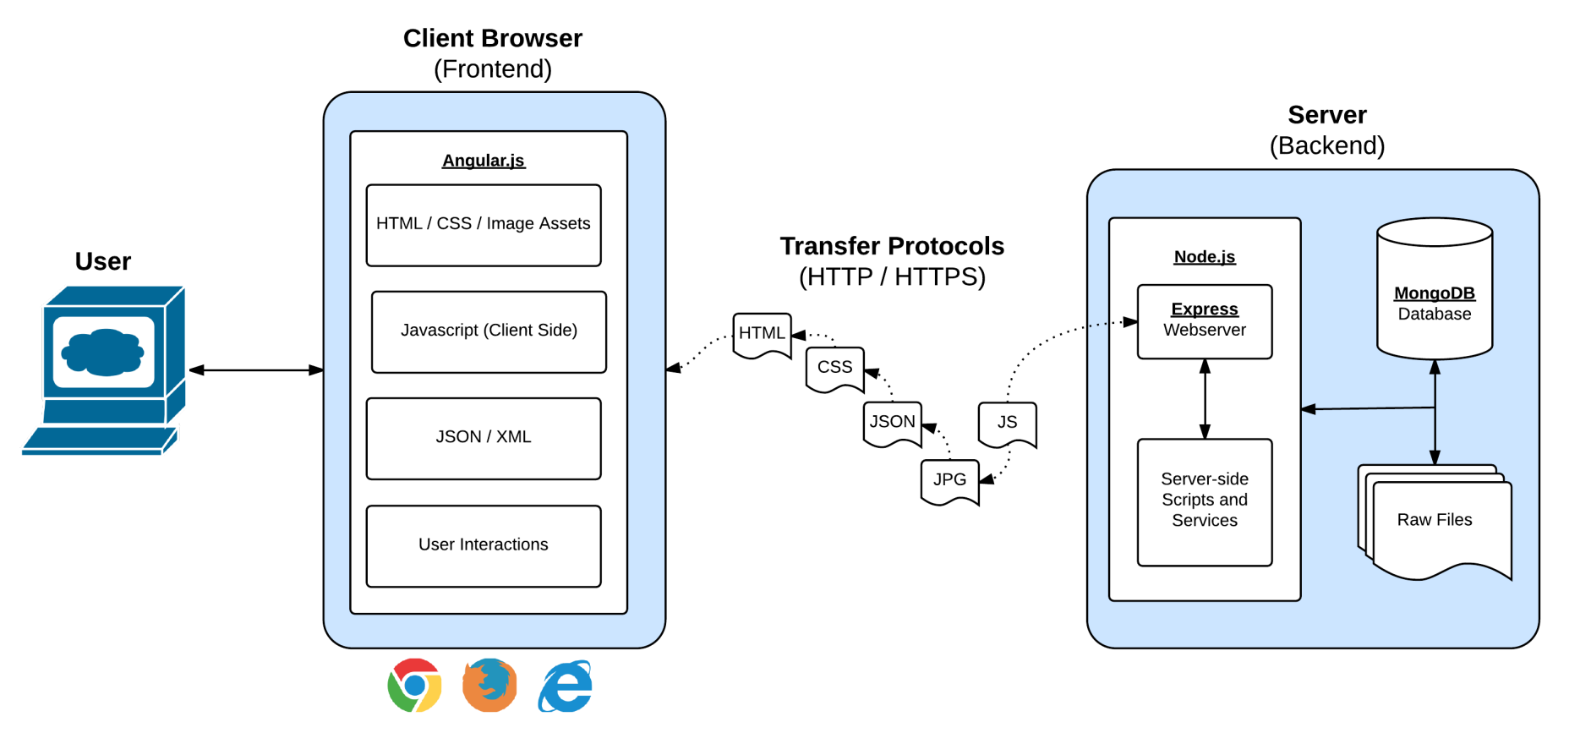
Full-Stack Development
In modern web apps, there’s a constant back-and-forth communication between two key components: the visuals displayed on the user’s browser (frontend) and the data and logic stored on the server (backend).

Slide 38
Full-Stack Development
Full-Stack Development is the concept of building every aspect of the web application – from the visuals and interactions, to the data transfer and processing.

Slide 39
Full-Stack Development
The Browser
Dev Tools
Server Side
HTML
CSS
JavaScript
jQuery
Bootstrap
SEO
Heroku
Git
GitHub
Templating Engines
Sessions
Writing tests
Node.js
Express.js
Creating APIs
MVC
User Authentication
ORM (Sequelize)
Databases
MySQL
MongoDB
API Interaction
APIs (Consuming)
JSON
AJAX
Real Time Cloud Database via Firebase
Algorithms
Design Patterns
CS Fundamentals
Cutting Edge Development
React.js

Slide 40
Google Foo – The Most Important Skill of All
What is Google Fu?

Slide 41
Let’s Get Crackin!

Slide 42
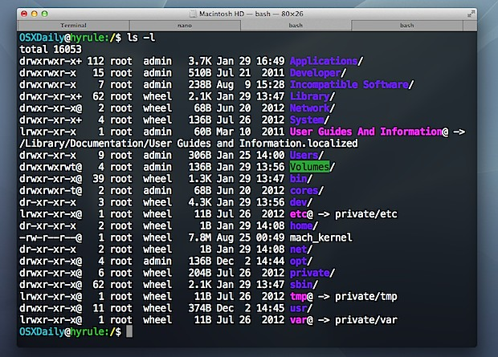
Intro to Console / Terminal

Slide 43
INSTRUCTOR DEMO
Instructor: Demo
(1-ConsoleCommands)

Slide 44
> YOUR TURN!
Activity: Get Situated | Suggested Time: 1 min
Assignment:
Make a folder on your desktop named code.
Put all of your code that you do inside of that folder.
Best Practices:
Always use lowercase for folder and file names.
Never put in spaces in your folder and file names.
Use dashes to separate.

Slide 45
> YOUR TURN!
Activity: Console Commands | Suggested Time: 12 min
Assignment:
From the Terminal / Console and using only the command line, create:
A new folder with the name of first_day_stuff.
A new HTML file with the name of first_day.html.
Open the current folder containing the new HTML file.
Bonus:
Create multiple directories/folders with the names one_folder and second_folder in one command.
Create multiple files with the names one.html and two.html in one command in the first_day_stuff directory.

Slide 46
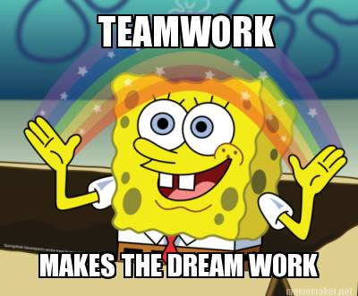
Intro to Console
Discuss with Neighbors

Slide 47
Hello, HTML

Slide 48

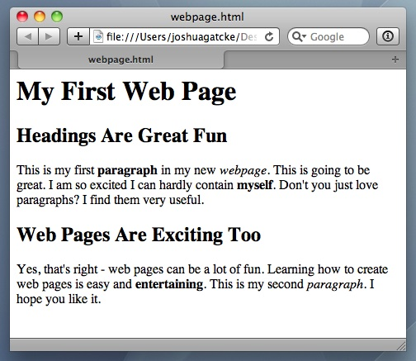
<title> Intro to HTML </title>
HTML is one of the three base languages behind every single website.
It defines all of the basic content and a bit of formatting.

Slide 49
> YOUR TURN
Assignment:
In a new HTML file, create the basic structure of an HTML document and include the following in it:
DOCTYPE declaration.
Head tag with a title tag.
H1 tag with a title of your choice.
Embed an image.
Create the following three links on your page:
One link that is target="_blank" so that it opens a new tab when clicked on.
Make the second link bold.
Make the third link a placeholder so it goes nowhere.
Bonus:
Create an ordered list of steps to make a sandwich.
Create an unordered list of 5 bands/musicians you like.
Create a table with 2 columns (animal class and animal name) and 4 rows of animals.
Use an alternate way of separating links without line breaks.
Embed a YouTube video of your favorite band/musician.

Slide 50
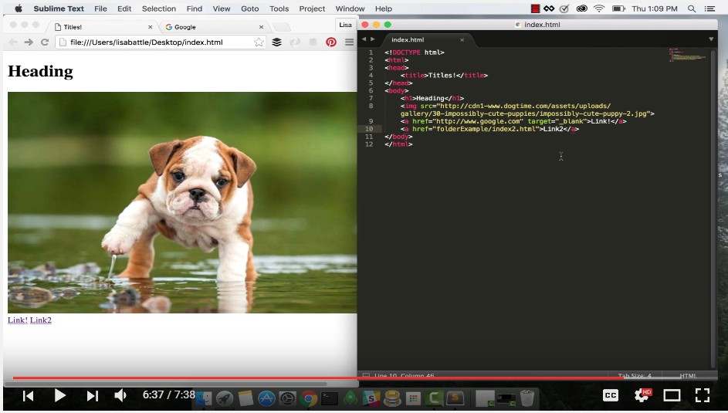
YouTube Video Walkthrough!
https://www.youtube.com/watch?v=ieb6Svbc10E&index=1&list=PLgJ8UgkiorCnMLsUevoQRxH8t9bt7ne14

Slide 51
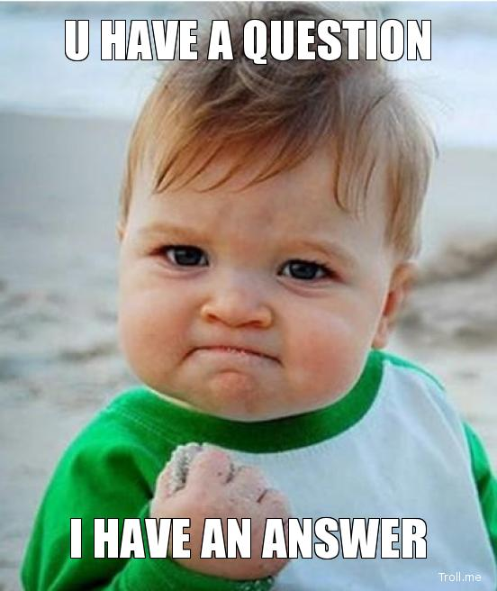
<title> Intro to HTML </title>
How’d it go?

Slide 52
Homework!

Slide 53
Homework “Due”: Next Class
By Next Class:
Figure out where the GitHub Repo is for our class.
Re-do the Terminal example from class today.
Re-do the HTML example from class today.
Watch the Walkthrough Video if you felt a bit lost.

